Slide 1


Slide 2

The gerund is the base form of a verb + -ing.
work - working
The infinitive is to + the base form of the verb
work – to work

Slide 3

Some verbs are followed by the gerund.
Acknowledge
Keep
Admit
Mention
Advise
Mind
Appreciate
Miss
Avoid
Postpone
Consider
Practice
Delay
Prevent
Deny
Quit
Discuss
Recall
Dislike
Recommend
Enjoy
Regret
Explain
Report
Finish
Risk
Forgive
Suggest

Slide 4
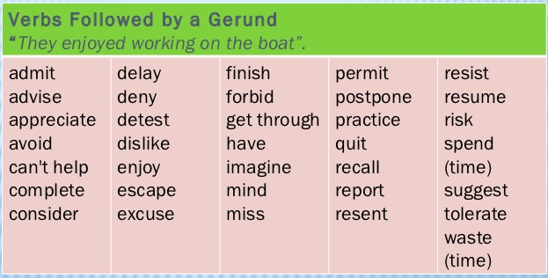

Slide 5

Some verbs are followed by the infinitive.
Agree
Begin
Decide
Expect
Hope
Learn
Need
Prefer
Seem
Wait
Want
Would like

Slide 6
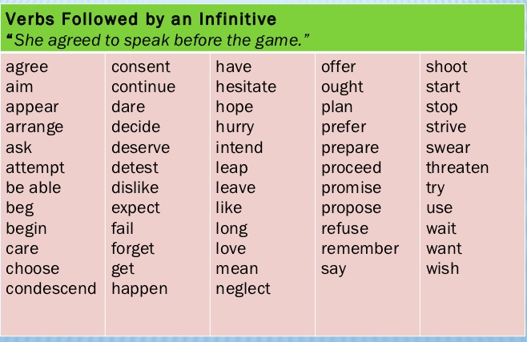

Slide 7
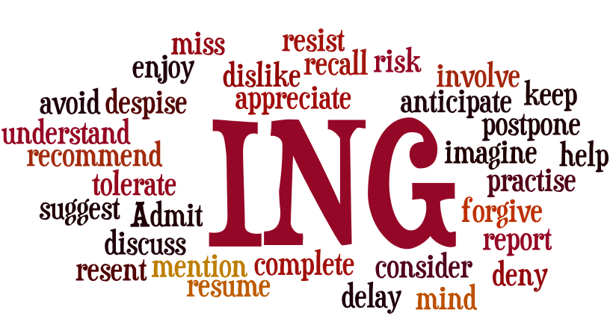

Slide 8
GERUNDS
Gerunds can be used as nouns. When the gerund acts as a subject, it is always singular and is followed by a third-person-singular form of the verb:
Voting is an important responsibility.
Windsurfing is very exciting.

Slide 9
Spelling rules
Infinitive | ING form
to feel | feeling
to go | going
to work | working
to sleep | sleeping
Infinitive | ING form
to fix | fixing
to enjoy | enjoying
to snow | snowing
Infinitive | ING form
to live | living
to have | having
to make | making
to take | taking
Infinitive | ING form
to lie | lying
to die | dying
to tie | tying
Infinitive | ING form
to stop | stopping
to sit | sitting
to plan | planning
to get | getting
to swim | swimming
Infinitive | ING form
to happen | happening
to enter | entering
to offer | offering
to suffer | suffering

Slide 10
A gerund can also act as object of certain verbs:
I enjoy working with people.
They have suggested improving health conditions in the city.
A gerund can follow a preposition like about, after, before, for, of, on, with and without:
I will call you after arriving at the office.
They always dream about going on holidays to Europe.
Go on practicing, you’ll do it better and better!

Slide 11
We often use go + gerund form to describe certain activities such as leisure or outdoor activities:
They went jogging with their dog.
How often do you go dancing?
She goes camping every summer with their friends.

Slide 12


The infinitive of purpose
To - infinitive

Slide 13
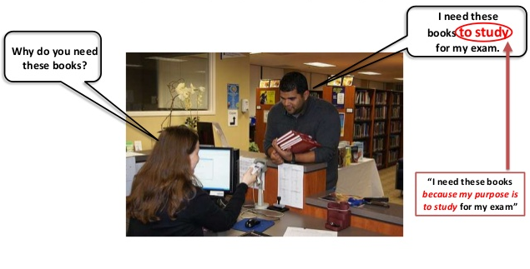
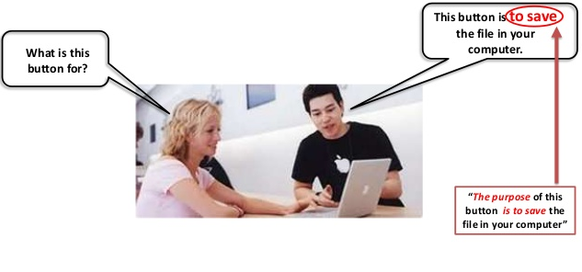
A verb in the infinitive form can be used to express purpose; using the to –infinitive we explain WHY we do something or why something happens:

Slide 14
A to - infinitive can be used to express purpose:
I'm calling to place an order for delivery.
Dany went to the door to open it.
To pass this test, you need to achieve a score of 60% or more.
In order and so as can be used before a to - infinitive for emphasis in more formal styles:
He took a book with him in order to have something to read on the train.
The parties started negotiations so as to reach an agreement as soon as possible.
In order to attract a wider audience, we need to rethink our marketing strategy.
The negative is always in order not + to - infinitive or so as not + to - infinitive:
He tiptoed through the hall so as not to be heard.
In order not to lose time, we must act at once.

Slide 15

PRACTICE

Slide 16
Gerunds as subjects and objects, infinitive of purpose:
http://www.ompersonal.com.ar/omgrammar/gerundiooinfinitivo.htm
http://www.ompersonal.com.ar/INTERMEDIATE/unit8/page2.htm
http://www.ompersonal.com.ar/INTERMEDIATE/unit8/page4.htm

